Slide 1
Aktorik und Sensorik mit intelligenten Materialsystemen 2
Computer Lecture 5: DE Material Model Simulation in Matlab
Gianluca Rizzello
gianluca.rizzello@mmsl.uni-saarland.de Saarland University

Slide 2
ASIM 2 - Computer Lecture 5 overview
GOAL: Identification of the DE material model parameters and implementation in MATLAB Simulink
From field control to voltage control
Experimental identification of DE material model
Simulation of DE model in MATLAB

Slide 3
Homework 1/2
Given the data files DE_relaxation_0V, DE_relaxation_2000V, the matlab script Parameter.m, the matlab s-function sDE_epsIn.m, and the Simulink file DE_epsIn.mdl:
By using the Simulink file DE_epsIn.mdl, modify the block diagram in order to be able to control the DE voltage, rather than the electric field. At low actuation frequencies, the relationship between electric field E and voltage v is given as follows, for a pure-shear deformation, where L₃ = 40∙10⁻⁶ m is the membrane thickness
The data contained in files DE_relaxation_0V, DE_relaxation_2000V correspond to experimental relaxation tests performed at constant voltage (no constant electric field!), where the corresponding voltage is reported in the file name, and for each file the three columns correspond respectively to: time, strain, stress. Find the best values of C₁, k_{v}, b_{v}, ε_{r} which allow to reproduce the experimental response with sufficient accuracy. Use the Simulink block diagram to reproduce the constant voltage tests, and change the parameters on the Parameter.m file to see their effects on the simulation. For each experiment, specify the initial condition in Parameter.m equal to the initial strain value.
By using the optimal parameter values of point 2), simulate the stress-strain curve for a sinusoidal strain ε = 0.5(1 + sin(2πft – π/2)), with f = 0.01, 0.1, 1 Hz, and E = 0. Comment the differences between the three cases.

Slide 4
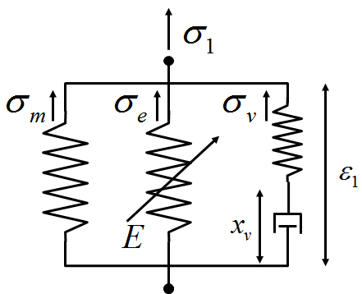
Homework 2/2
Adopted DE material model
Effects of parameters on relaxation response

